Slide 1
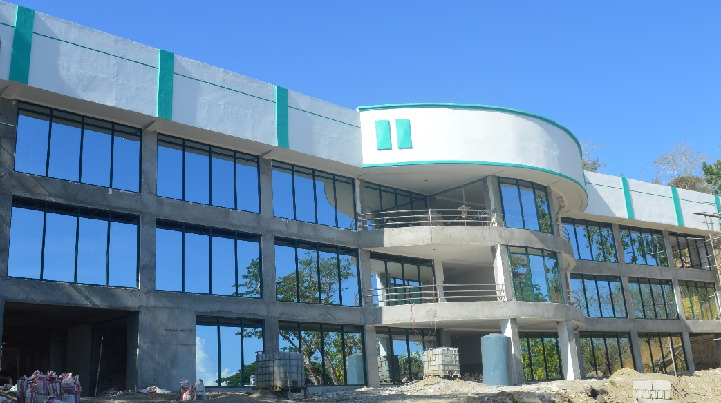
Administration
SUC Levelling
2016-17; 2017-18; 2018-19

Slide 2
ADMINISTRATION
SUC Levelling 2016 -2019
Key Results Areas (KRAs)
KRA 1: Quality and Relevance of Instruction (II = 5; III = 8; IV=11; V=14)
KRA 2: Research Capability and Output (II = 4; III = 7; IV=10; V=13)
KRA 3: Services to the Community
KRA 4: Management of Resources
Note: Level II = 15; Level III = 24; Level IV = 33; Level V=42
Notes:
Lagyan ng percentage per Vertical Bar. Kung ilang pecent ang binaba at tinaas sa year period.

Slide 3
ADMINISTRATION
SUC Levelling 2016 - 2019
Needs Improvement
In-country Mobility
Number of COE/COD/NUCAF/PIAF
Research Centers vs Researchers to Plantilla Positions
Research Published and Presentations (exclusion of in-house)
Citations
Inventions (Patent vs Utility Model; utilization and commercialization)
Note: Supporting documents
Notes:
Lagyan ng percentage per Vertical Bar. Kung ilang pecent ang binaba at tinaas sa year period.

Slide 4
ADMINISTRATION
SUC Levelling 2016 - 2019
Needs Improvement
Linkages
Adopters and Viable Demonstration Projects (Financial documentations)
Faculty Staff Development and International Trainings
Recognition and Awards
Note: Supporting documents
Notes:
Lagyan ng percentage per Vertical Bar. Kung ilang pecent ang binaba at tinaas sa year period.

Slide 5
Administration
PBB Compliance

Slide 6
ADMINISTRATION
PBB Compliance
Needs Improvement
Transparency Seal (posting of signed documents in the website)
ISO QMS Certification
COA Requirements and Compliance
Anti-Red Tape Requirements and Compliance
Physical Accomplishments (Performance Indicators) – supporting documents
Notes:
Lagyan ng percentage per Vertical Bar. Kung ilang pecent ang binaba at tinaas sa year period.

Slide 7
Administration
CHED CHECKS Compliance

Slide 8
ADMINISTRATION
CHED Checks Compliance
Needs Improvement
Encoding and Posting
Validation and Approval
Record Keeping and Administration
Coordination and communication (deadline)
Notes:
Lagyan ng percentage per Vertical Bar. Kung ilang pecent ang binaba at tinaas sa year period.

